Slide 1
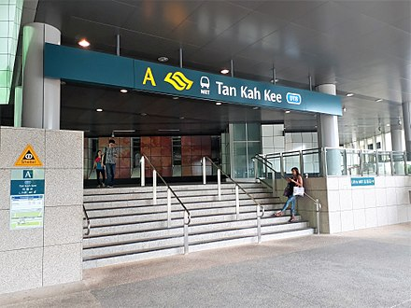
Hokkiens in Singapore

Slide 3
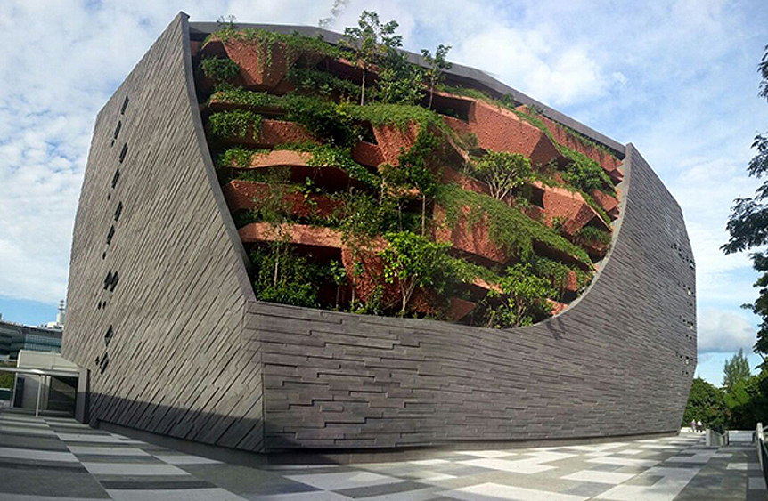
Notes:
Lee kong chian natural history museum

Slide 4
Lingua Francas before 1965

Slide 6
Notes:
Hokkien due to their numbers advantage, it has become the bridging group between the Chinese dialects

Slide 8
Mr Lee Kuan Yew speaking in Hokkien (1966)
https://www.youtube.com/watch?v=EHsTXFSZI34&t=10s

Slide 10

Hokkien peng (Hokkien soldier)
video

Slide 11
https://www.youtube.com/watch?v=VrUUYAD__8s&t=1579s

Slide 12
Straits-born Chinese vs Sinkheh

Slide 13
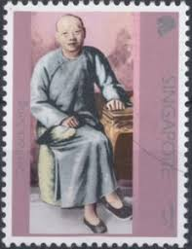
Melaka and Singapore
Notes:
Straits born Chinese
- Important 1850….

Slide 14
Si Hoo Keh（薛佛记）
Notes:
Straits born chinese

Slide 15
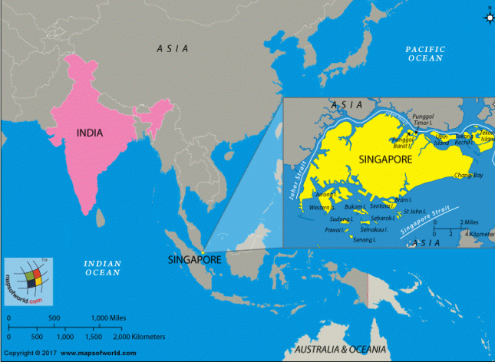

Slide 16
Hokkien spoken in Singapore is a mixture of the Zhangzhou (漳州)accent and the Quanzhou (泉州) accent
Notes:
Zhang zhou is for straits born
Sinkthtt is from quanzhou

Slide 17
Variation in pronouncing the word猪 ‘pig’ and 去 ‘go’ in Singapore Hokkien

Slide 18
https://www.youtube.com/watch?v=uoUWCZsvYMI&t=711s
Notes:
Quanzhou version dominates the straits born version

Slide 19
https://www.youtube.com/watch?v=FXuSxe4HAYk&t=434s
7：00

Slide 20
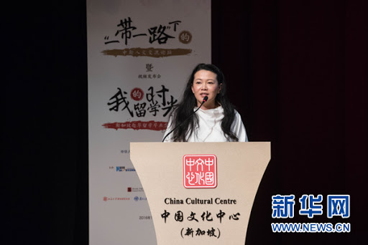
Guest lecture on Singapore Hokkien Huay Kuan in week 5
Ms Josephine Gan

Slide 21
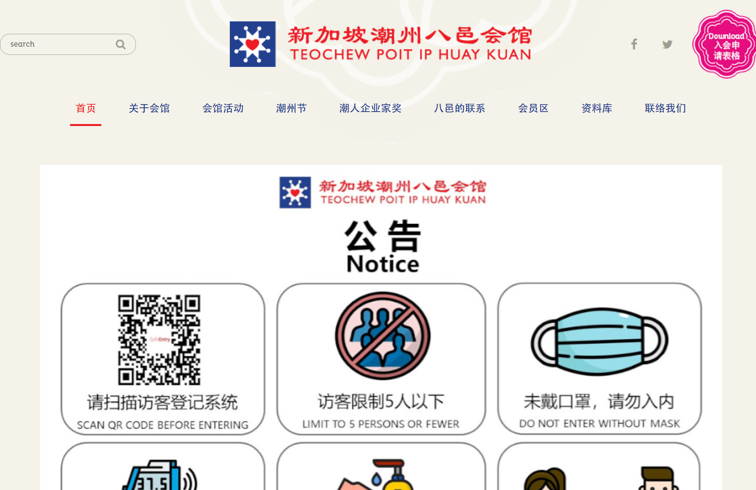
Notes:
8 counties

Slide 22
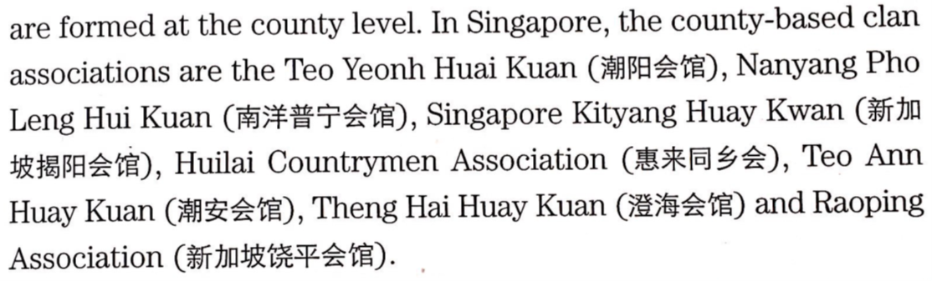
County-based clan associations for the Teochew dialect group

